Slide 1
Video 3: CADS in practice
Maria Leedham
Full resource: https://www.ncrm.ac.uk/resources/online/all/?id=20855

Slide 2
CADS tools and techniques
From corpus software:
From discourse analysis:
concordancing
frequency lists
collocates
plot dispersions
keywords
automated semantic tagging
...
critically read texts
qualitative analysis of a sample of language data
manually code randomised examples
thematic analysis
combining text analysis with participant data (e.g. interviews, focus groups, surveys, contextual data)
...
Notes:
Recap
What you can do with a corpus
Descriptive statistics on mean sentence length, variety of lexical items used, (per text and for the whole corpus)
Produce frequency word or phrase lists
Get concordance lines and sort these in different ways
Look at collocate lists for insight into the data
Find key words and phrases compared to a reference corpus
Look at plot dispersions to see how a linguistic feature is used across whole texts/the corpus
Search for similar lexical items/chunks through semantic or Part of Speech tagging
Combine with discourse analysis techniques
Read individual texts and form hypotheses
Extract randomised examples and manually code (within corpus software, qual software, Excel, etc)
Thematic analysis
Draw on interviews/ focus groups /survey /contextual data to inform the textual data

Slide 3
EXAMPLE CADS PROJECT B:
Portrayal of social workers in the UK press

Slide 4
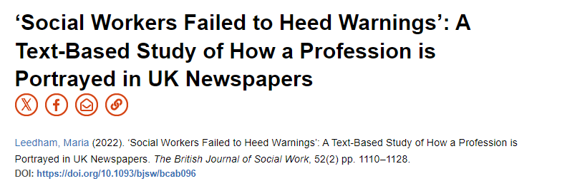
Social workers in the press
Aim: To explore the commonly-expressed belief of social workers that UK newspapers portrayed them negatively.
RQs
What are the proportions of positive, negative and neutral mentions of social worker(s) in the UK press?
(ii) What are the dominant subcategories within each of these three groupings?
Notes:
Going to launch straight in to an example to show the value of a small corpus

Slide 5
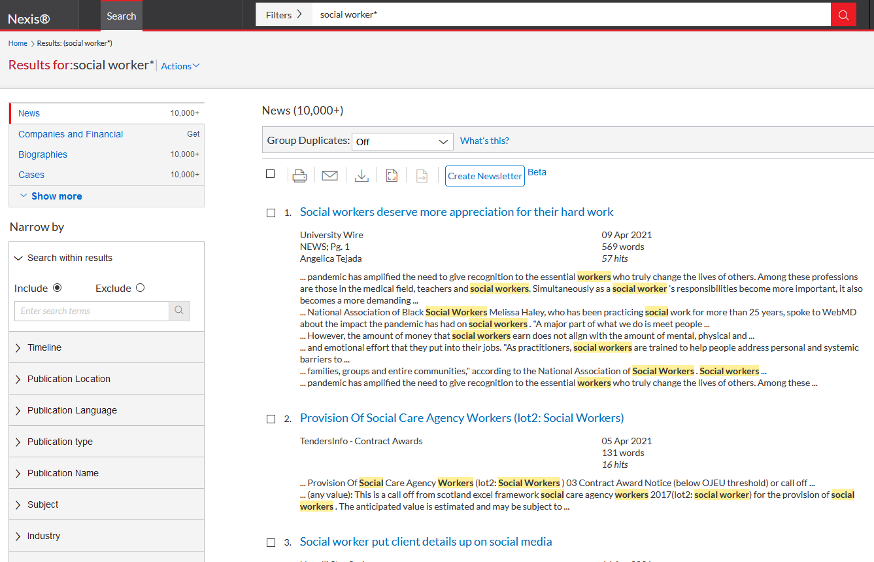
Extracting articles from Nexis UK
The social workers asked me the most prying questions
2) I'm not eligible - basically, I can speak and get myself out of bed and into my chair, so I'm not disabled enough. Even my social worker seems to be at a loss, and just says how sorry she is.
3) Jurors were told how two days later, a social worker had seen Scarlett looking 'chatty, alert and happy’.
4) It gives gruelling details of how generations of children, living in a climate of fear, were horrendously abused by predatory carers in homes and foster families while Nottingham city council and Nottinghamshire county council, as well as police, social workers and the Crown Prosecution Service, repeatedly failed to act.
5) And today it can be revealed that prostitute Louise Porton, 23, conned social workers just four days before she "squeezed the life" out of the eldest of her two baby girls.
Notes:
- The online database of newspaper and business information Nexis UK was used to search for social worker(s) in all print and online UK national newspapers in the three month period 7th May 2019 to 6th August 2019 (filtered to include only UK national press).
987 ‘hits’ within 736 articles covering 5,170,947 words.
The collection of texts (or ‘corpus’) was examined using corpus linguistic software as this allows the analyst to slice through the data in different ways and thus obtain fresh perspectives whilst retaining the wider context of individual articles.

Slide 6
Social workers in the press: Examples
The social workers asked me the most prying questions
2) I'm not eligible - basically, I can speak and get myself out of bed and into my chair, so I'm not disabled enough. Even my social worker seems to be at a loss, and just says how sorry she is.
3) Jurors were told how two days later, a social worker had seen Scarlett looking 'chatty, alert and happy’.
4) It gives gruelling details of how generations of children, living in a climate of fear, were horrendously abused by predatory carers in homes and foster families while Nottingham city council and Nottinghamshire county council, as well as police, social workers and the Crown Prosecution Service, repeatedly failed to act.
5) And today it can be revealed that prostitute Louise Porton, 23, conned social workers just four days before she "squeezed the life" out of the eldest of her two baby girls.
Notes:
Began by browsing Nexis uk and searching for social worker. Downloaded some examples. What sort of negativity surrounds the job title ‘social worker’? Is there potential for a study on this?

Slide 7
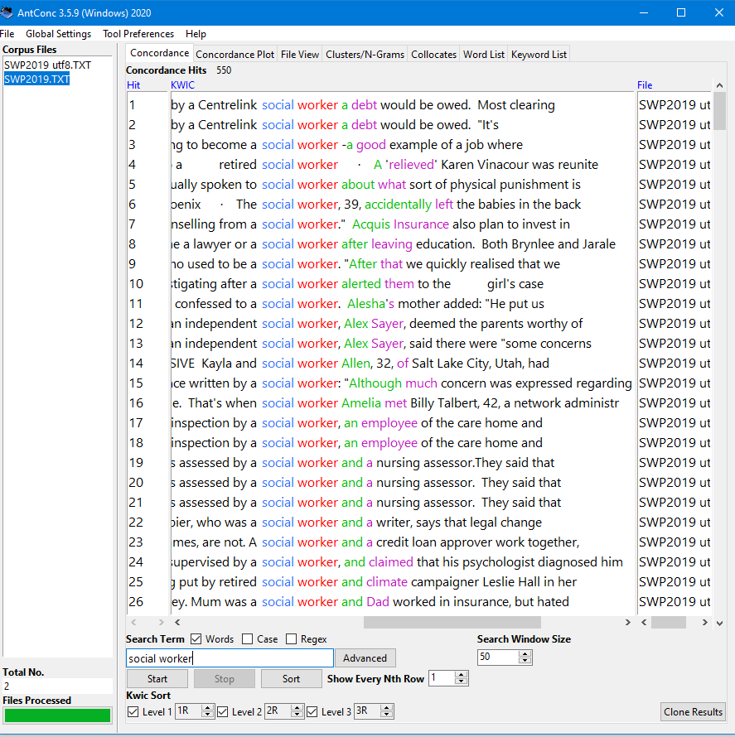
Viewing concordance lines in AntConc
Notes:
- articles were saved as text files and the resulting corpus (named ‘SWP2019’) was loaded into the corpus linguistics software. Duplicate texts were removed and rechecked in Excel.
The remaining 974 hits were concordanced, that is, given with the search term in the middle of each line so that the immediate language surrounding each hit (the co-text) can be viewed.
Lines should be read vertically, rather than horizontally, to scan the immediate co-text occurring to the left and right of the search term.
Concordancing thus enables the analyst to search for any word used in the corpus, to view the search term in different ways, and also to expand each concordance line to see the fuller context: these different ways in bring a fresh perspective to the dataset.
Here’s what the data looks like in antconc – sorted 1R, 2R, 3R
KWIC = key word in context

Slide 8
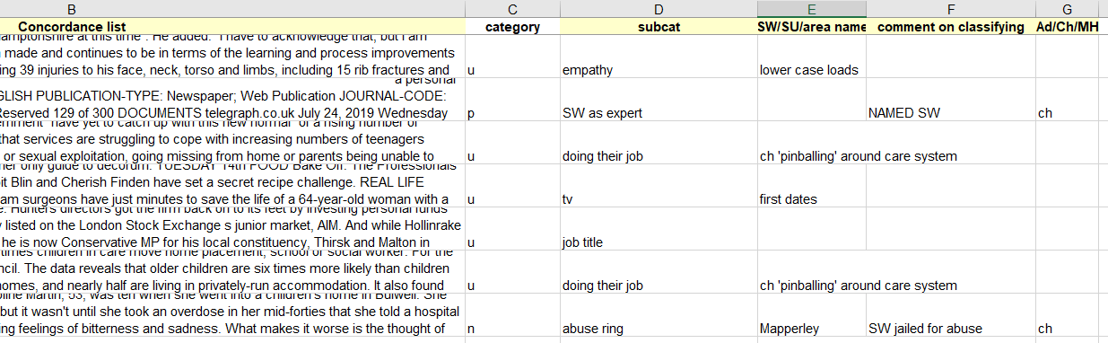
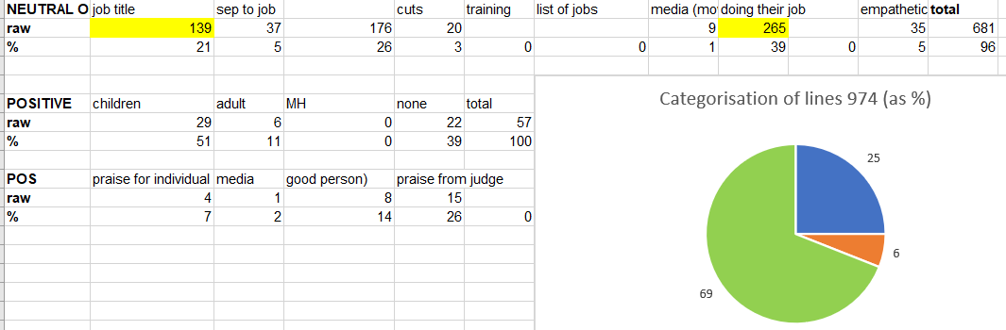
Coding and sorting in Excel
Notes:
- The online database of newspaper and business information Nexis UK was used to search for social worker(s) in all print and online UK national newspapers in the three month period 7th May 2019 to 6th August 2019 (filtered to include only UK national press).
987 ‘hits’ within 736 articles covering 5,170,947 words.
articles were saved as text files and the resulting corpus (named ‘SWP2019’) was loaded into the corpus linguistics software package WordSmith Tools v.7 (Scott, 2019). Duplicate texts were removed in WordSmith (defined by the Tool as 500 identical characters centred on the search word), and rechecked in Excel.
The remaining 974 hits were concordanced, that is, given with the search term in the middle of each line so that the immediate language surrounding each hit (the co-text) can be viewed.
Lines should be read vertically, rather than horizontally, to scan the immediate co-text occurring to the left and right of the search term.
Concordancing thus enables the analyst to search for any word used in the corpus, to view the search term in different ways, and also to expand each concordance line to see the fuller context: these different ways in bring a fresh perspective to the dataset.

Slide 9
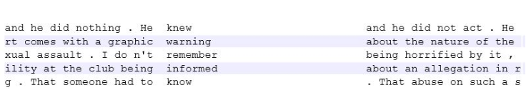
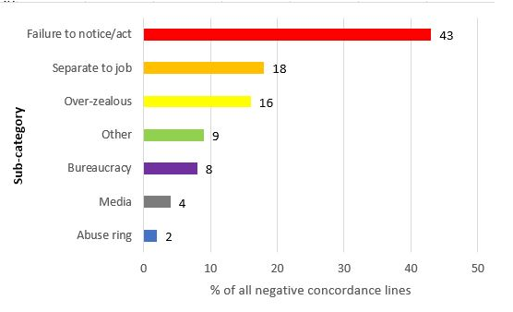
Classifying the lines
Notes:
The broadest level of classification of each of the 974 instances of social worker(s) in the whole corpus into ‘negative’, ‘positive’ and ‘neutral’ mentions gave 25% of instances as negative (242 raw count), 6% positive (57) and 69% neutral (675).
By far the largest negative classification category is ‘failure to notice/act’, denoting occurrences ranging from social workers being dismissive of concerns raised by others (Example 4), or failing to take sufficient action (5, 6) to (rarer) instances where professionals are taken in by the perpetrator (1, 7).

Slide 10
Social workers in the press: Examples
Example | Classification
The social workers asked me the most prying questions | Over-zealous
2) I'm not eligible - basically, I can speak and get myself out of bed and into my chair, so I'm not disabled enough. Even my social worker seems to be at a loss, and just says how sorry she is. | Bureaucracy
3) Jurors were told how two days later, a social worker had seen Scarlett looking 'chatty, alert and happy’. | Failure to notice
4) It gives gruelling details of how generations of children, living in a climate of fear, were horrendously abused by predatory carers in homes and foster families while Nottingham city council and Nottinghamshire county council, as well as police, social workers and the Crown Prosecution Service, repeatedly failed to act. | Failure to act
5) And today it can be revealed that prostitute Louise Porton, 23, conned social workers just four days before she "squeezed the life" out of the eldest of her two baby girls. | Other: Gullible
Notes:
Here are the original negative lines again. So from an initial idea, rather than simply reading newspapers, I was able to quantify the negativity, positive and neutral instances, then systematically sort these and make some claims about how SWs are viewed in the press. Ideally need a second rater for some inter-rater reliability – I have tried using Chat GPT 3.5 but wasn’t great – improving all the time
Corpus used as a way in. then qualitative research. This is an example of corpus-assisted discourse studies - CADS

Slide 11
www.ncrm.ac.uk

